Slide 1

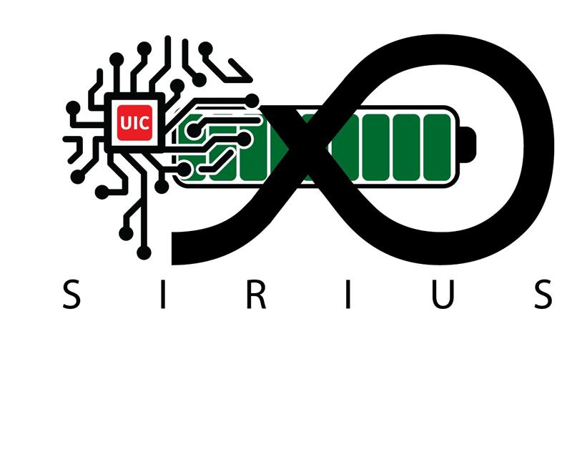
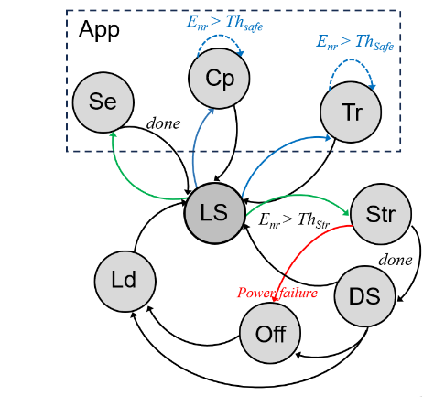
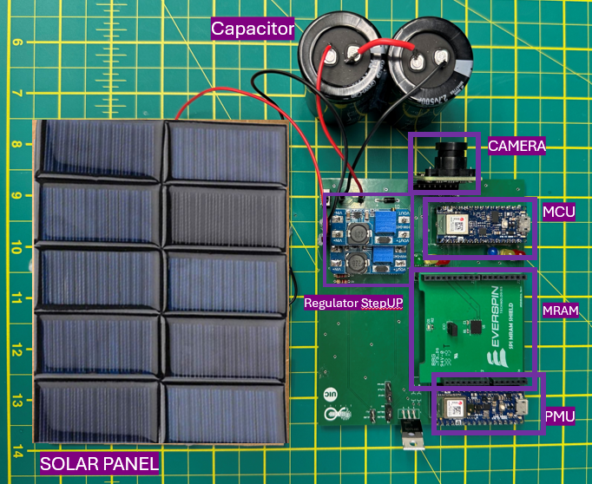
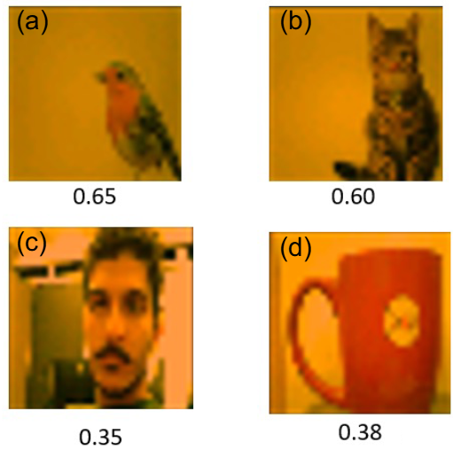


SunSift: Solar-Powered Intelligent Sensing through Informative Sample Selection
Shayan Gerami, Sepehr Tabrizchi, Omer Kurkutlu, Rebati Gaire, and Arman Roohi
Department of Electrical and Computer Engineering
University of Illinois Chicago, Chicago, IL
Motivations
Billions of IoT devices are expected to shape future smart cities, healthcare, and agriculture systems. Yet, their dependence on batteries poses serious sustainability, cost, and scalability challenges. SunSift bridges this gap by enabling reliable, energy-aware inference on solar-powered, batteryless nodes, moving toward sustainable and autonomous edge intelligence.
SunSift Approach
SunSift introduces a lightweight, voltage-driven finite state machine to manage intermittent execution on solar-powered IoT nodes. By monitoring three energy thresholds, the system dynamically transitions between sensing, computing, storing, and sleeping states to preserve progress across unpredictable power failures. Selective MRAM checkpointing ensures only critical data is saved at CNN layer boundaries, minimizing overhead while enabling reliable forward progress. Integrated with TensorFlow Lite for Microcontrollers, SunSift classifies informative vs. non-informative samples, supporting sustainable federated learning on resource-constrained, battery less devices.
Objectives
Develop a lightweight framework for CNN inference on batteryless, solar-powered IoT nodes.
Design a finite state machine to manage intermittent execution under fluctuating energy conditions.
Implement selective MRAM checkpointing to reduce storage overhead while preserving progress.
Distinguish between informative and non-informative samples to support federated learning.
Results
SunSift achieves 71.51% accuracy in identifying informative samples from CIFAR-10, effectively distinguishing underrepresented categories from well-represented ones. By leveraging selective MRAM checkpointing and a voltage-aware state machine, the system maintains reliable CNN inference despite frequent power interruptions. Deployment on Arduino Nano 33 BLE boards validates its practicality on real, resource-constrained hardware, demonstrating that batteryless, solar-powered IoT nodes can support sustainable federated learning and edge intelligence.
References
[1] D. Balsamo et al., Hibernus: Sustaining computation during intermittent supply for energy-harvesting systems, IEEE ESL, 2014. [2] K. Maeng et al., Alpaca: Intermittent execution without checkpoints, Proc. ACM OOPSLA, 2017. [3] S. Tabrizchi et al., SRC: Sustainable reactive computing for battery-free edge intelligence, IEEE IGSC, 2024. [4] R. Gaire et al., Encode: Enhancing compressed deep learning models through informative sample selection, IEEE ICMLA, 2023.
For more information and publications list, Please visit the SIRIUS Lab website:
Email: sgera@uic.edu

